Slide 1
Business Intelligence in Practice Data analysis with Python
Dr. Kate Han

Slide 2
Programming Concept before you start
Variable
Function
Library
Execution
If Else
For Loop
…

Slide 3
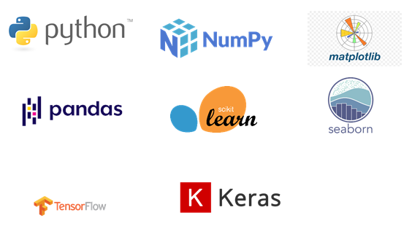
Programming Libraries
A programming library is a collection of prewritten code that programmers can use to optimize tasks.
This collection of reusable code is usually targeted for specific common problems. A library usually includes a few different pre-coded components.

Slide 4

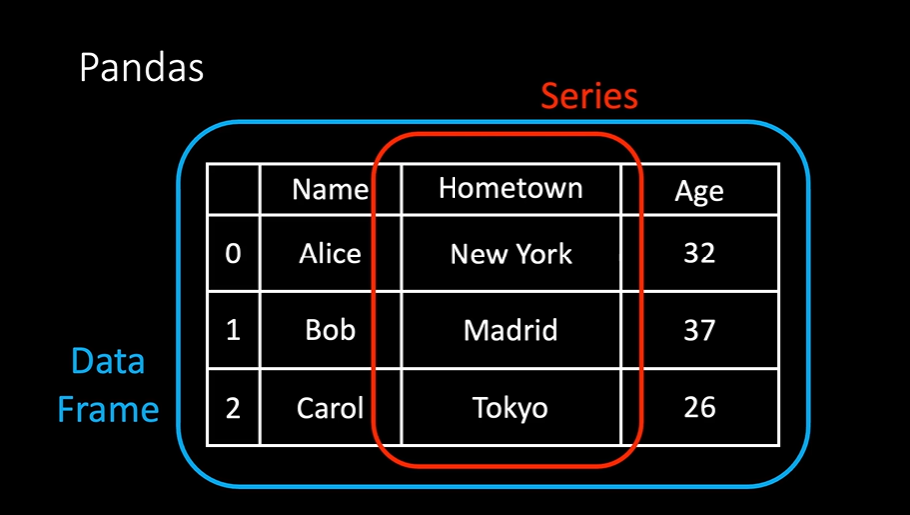
Data Collection
What you need?
Pandas
Get Pandas library
Go to environment in Anaconda
Install pandas if required

Slide 5
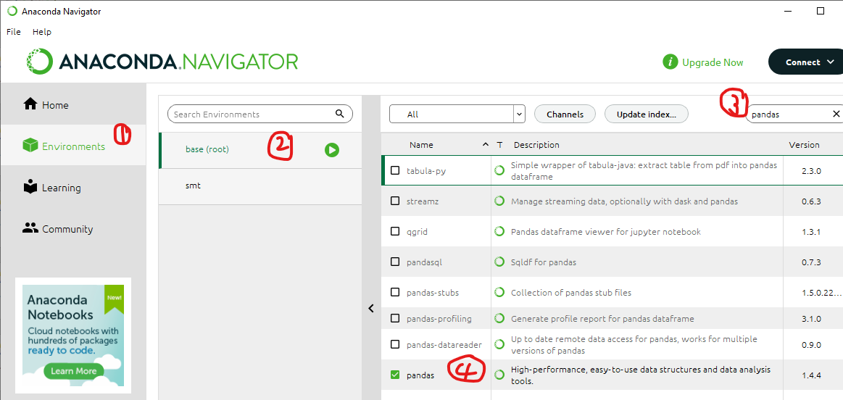
Data Collection
What you need?
Pandas
Get Pandas library
Install Pandas on Anaconda->

Slide 6
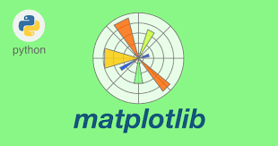
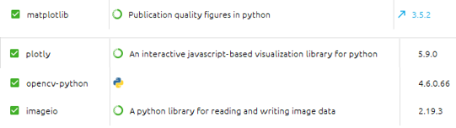

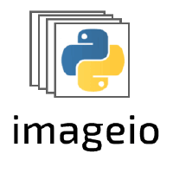

Libraries
What else do you need?
Matplotlib
Plotly
Imageio
Opencv-python

Slide 7
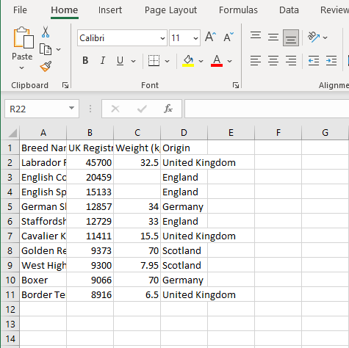
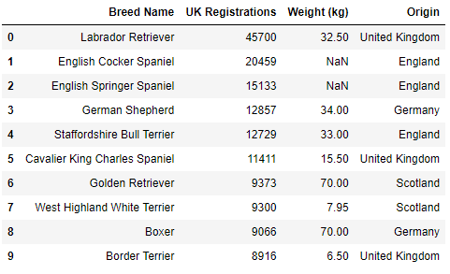
Check the data with Python
Excel
Jupyter Notebook

Slide 8
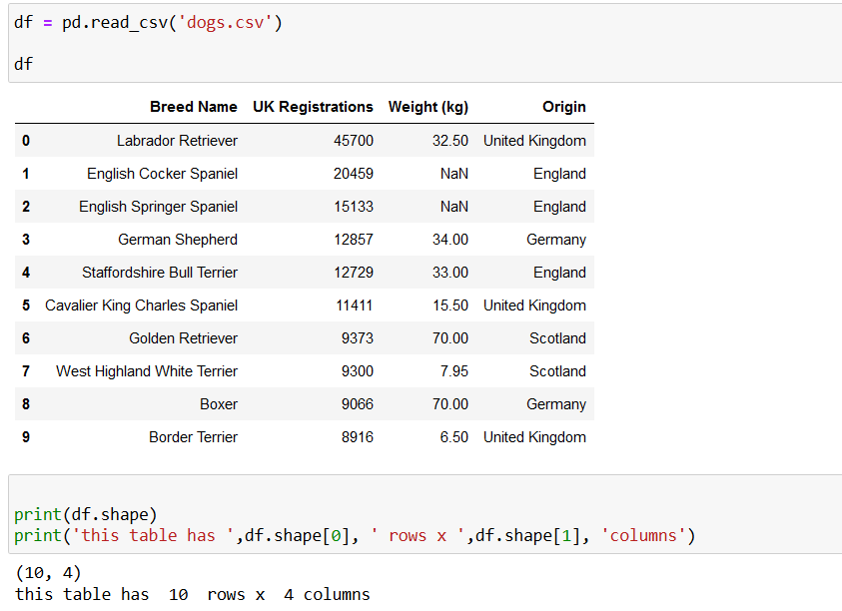
Read the data with Python
import pandas as pd
df = pd.read_csv('dogs.csv’)
Read the data with Python
Print(df.shape)
Here, shape means the loaded table’s shape

Slide 9
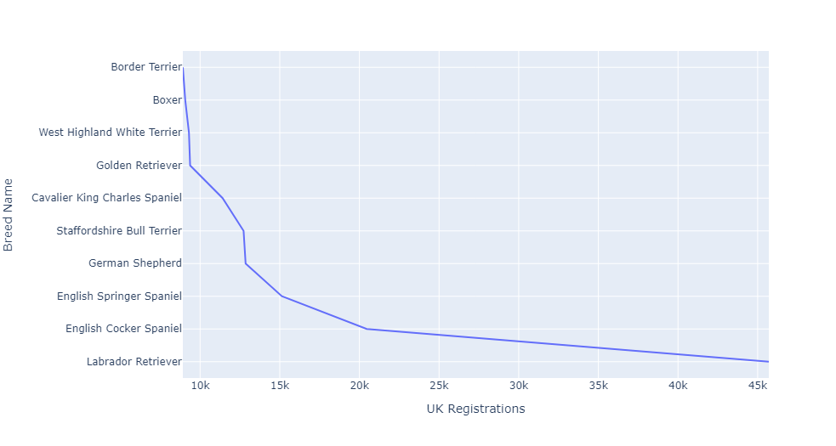
Line Chart
import plotly.express as px
px.line(df, x="UK Registrations", y="Breed Name")

Slide 10
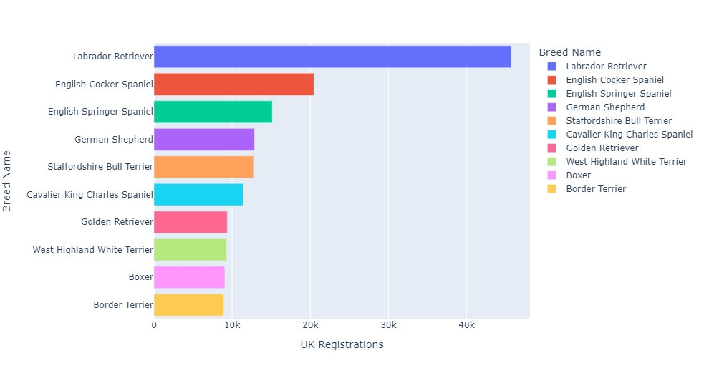
Bar Chart
import plotly.express as px
px.bar(df, x="UK Registrations", y="Breed Name", color="Breed Name")

Slide 11
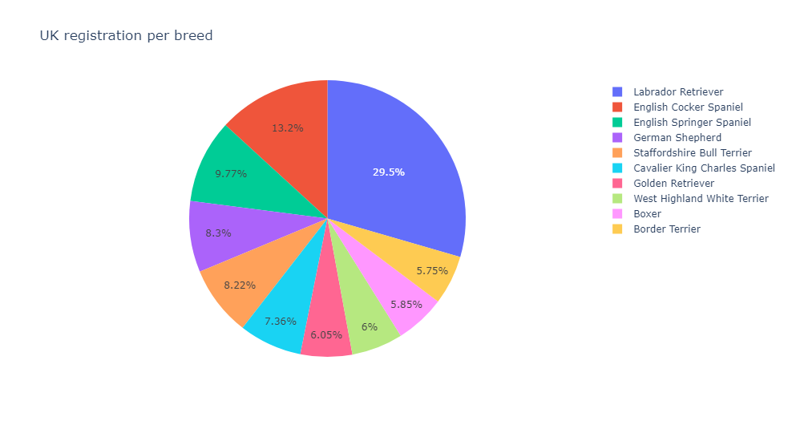
Pie Chart
import plotly.express as px
px.pie(df, values="UK Registrations", names="Breed Name", title="UK registration per breed")

Slide 12
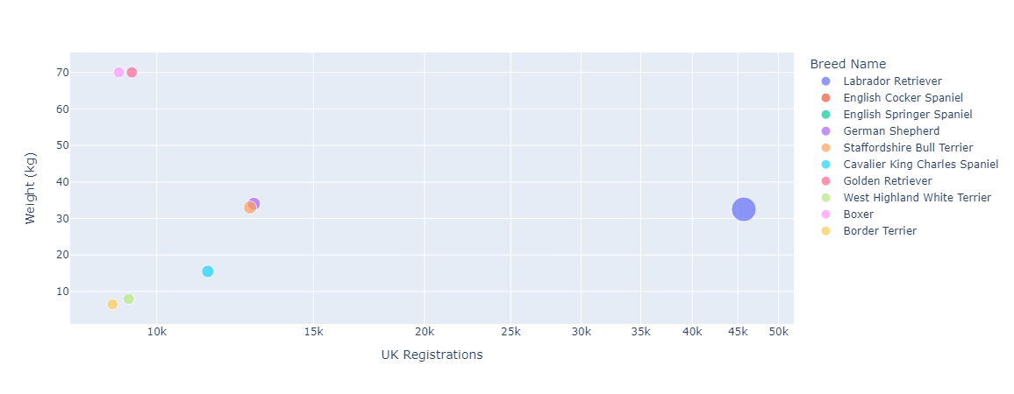
Scatter Plot
import plotly.express as px
px.scatter(df, x="UK Registrations", y="Weight (kg)", color="Breed Name")

Slide 13
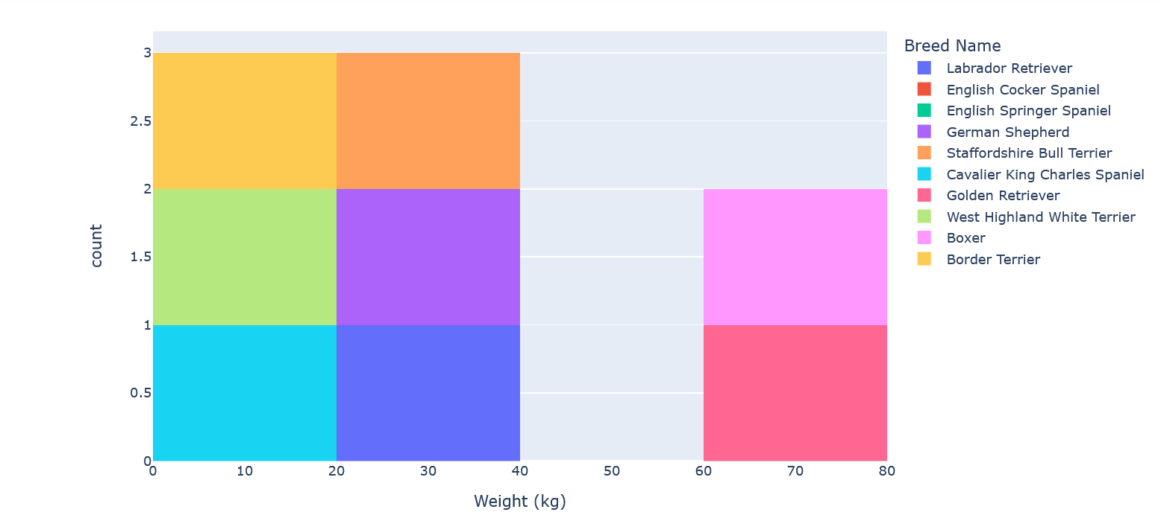
Histogram chart
import plotly.express as px
px.histogram(df, y="Weight (kg)", color="Breed Name")

Slide 14


Now try you own dataset!
Where to find data?
Kaggle: Your Machine Learning and Data Science Community
data.world | The Cloud-Native Data Catalog

Slide 15
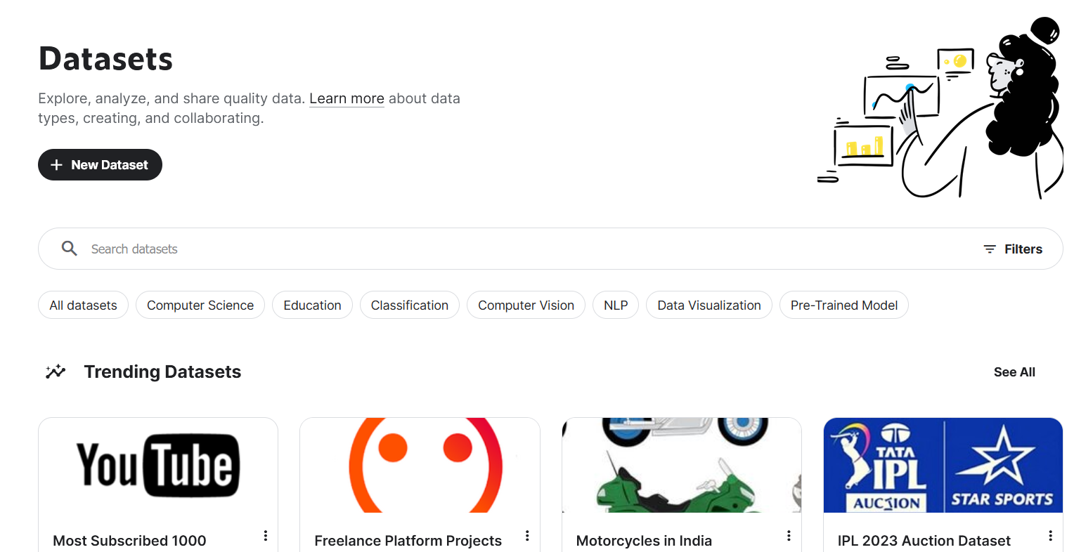
Kaggle Dataset
Dataset can be interesting!

Slide 16
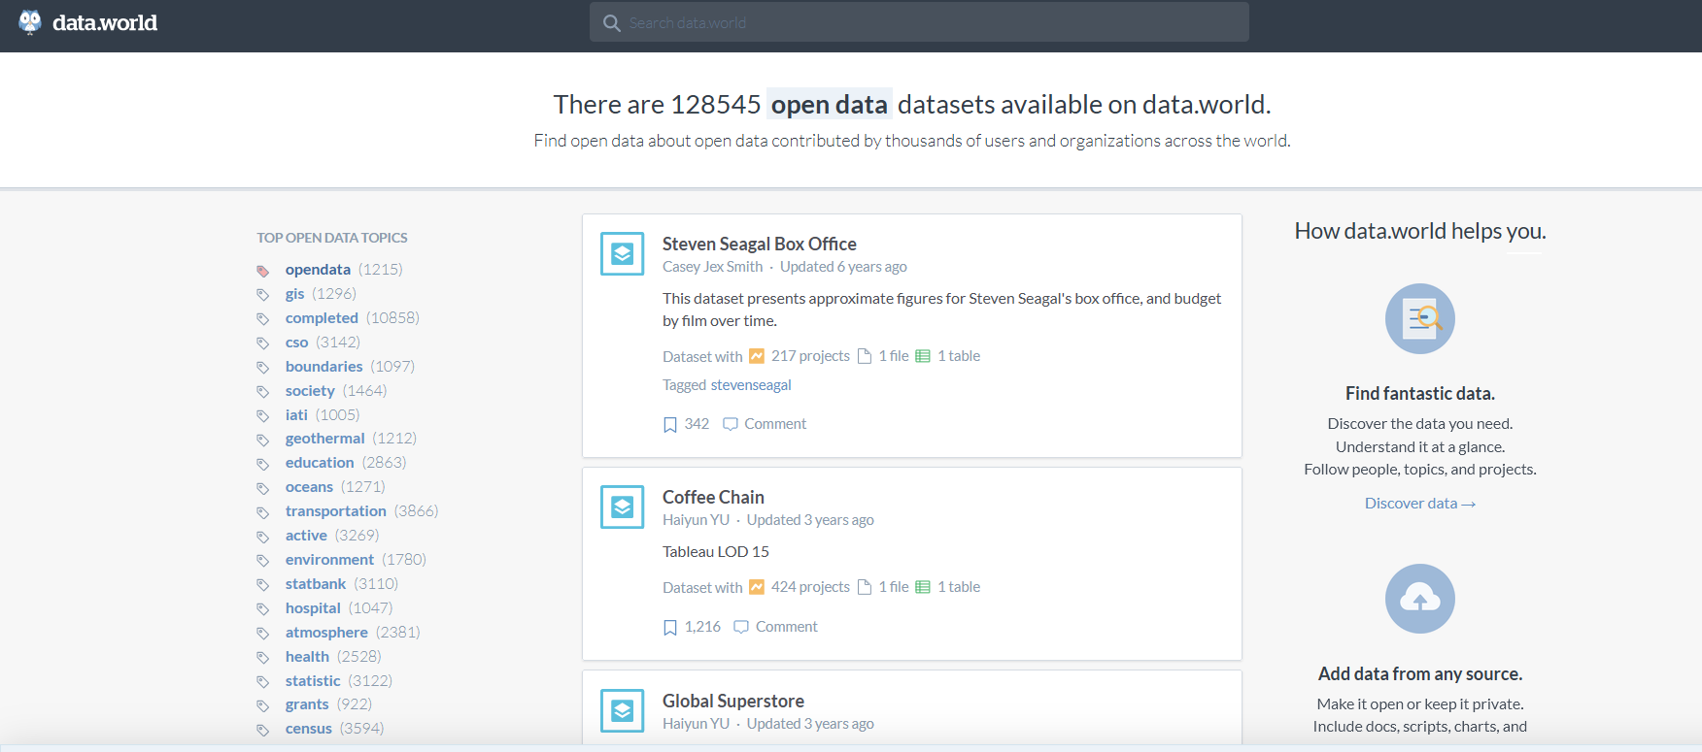
Data.World

Slide 17
Thank you!

